Slide 1

Go, change the world
RV College of
Engineering
Naive Bayes Classifier

Slide 2
Naïve Bayes
Classifier

Slide 3
INDEX
Quick Recap
Bayes Theorem
Naïve Bayes: Introduction
Bayesian Approach
Naïve Bayes: Assumption
Naïve Bayes: Classifier
Example: Spam Messages
Summary

Slide 4
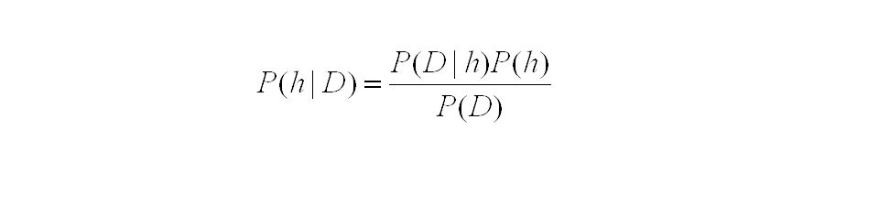

BAYES THeorem
In ML, we want to determine the best hypothesis h from space H, given the data D
best hypothesis = most probable hypothesis
Maximally probable hypothesis = maximum a posteriori (MAP) hypothesis
Likelihood
Prior Probability
Posterior Probability
Plausibility

Slide 5
NAÏVE BAYES
CLassifier

Slide 6
Naïve Bayes Classifier - Introduction
Naive Bayes Learner: Highly practical Bayesian learning method
In some domains, its performance is in par to that of neural networks and decision tree learning
It applies to learning tasks where each instance x is described by a conjunction of attributes values {a, b, c} and where the target function f(x) can take any value from some finite set V
Instance x {Weather: Sunny, ^ Traffic: Less, ^ Store: Open}
f(x) 1
V {GO, Don’t GO}
A set of training examples of the target function is provided

Slide 7
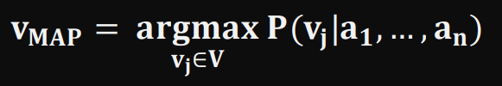
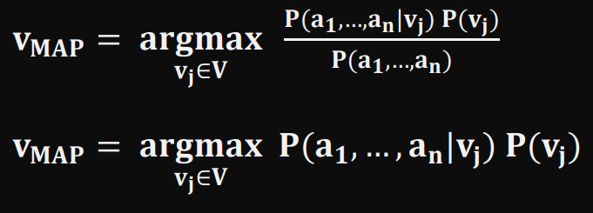
Bayesian Approach
New instance y is presented, described by the tuple of attribute values {a, b, c}
“Naïve Bayes Classifier” is tasked to predict the target value f(x) (or classify it)
The Bayesian approach: (to classify the new instance)
Assign the most probable target value, V_{MAP,} given the attribute values {a, b, c}
By Bayes Theorem
we P(a₁,…,a_{n}) is a constant independent of v_{j}
_{-----→ Equation 1}

Slide 8
a1, a2, a3, a4,… a_{n} | v_{j}
Rain, No Traffic, Bike, Close | 1
Sun, No Traffic, No Vehicle, Open | 1
Sun, Traffic, Flight, Open | 1
Rain, Traffic, Car, Close | 0
Rain, Traffic, Bike, Close | 0
Sun, Traffic, Car, Close | ?
P(v_{j})
P(1) = 3/5 P(0) = 2/5
P(a1, a2, … a_{n} | v_{j} )

Slide 9
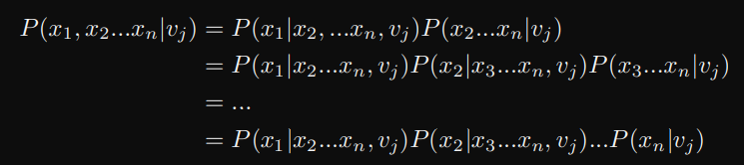
Shortcoming: Bayesian Approach
Estimating the different P(a1, a2, … a_{n} | v_{j}) terms is not feasible unless we have a very large set of training data. The problem is:
Number of these terms = no of possible instances * no of possible target values
Therefore, every instance in instance space is to be observed many times to obtain reliable estimates

Slide 10

ASSUMPTION: Naïve Bayes
The naive Bayes classifier is based on the simplifying assumption that the
attribute values are conditionally independent given the target value
For a given the target value of the instance, the probability of observing conjunction a1, a2, … a_{n} is just the product of the probabilities for the individual attributes:
P(a1, a2 … , a_{n} | v_{j} ) = P(a1 | v_{j}) * P(a2 | v_{j}) * … * P(a_{n} | v_{j})

Slide 11
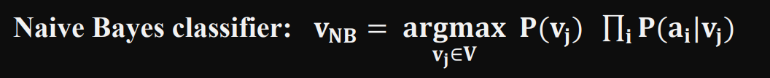
NAÏVE BAYES CLASSIFIER

Slide 12
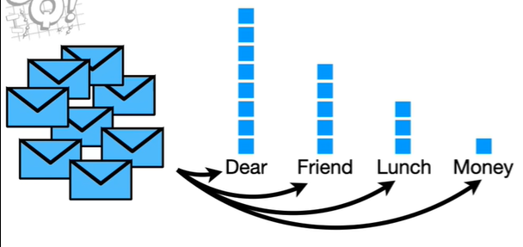

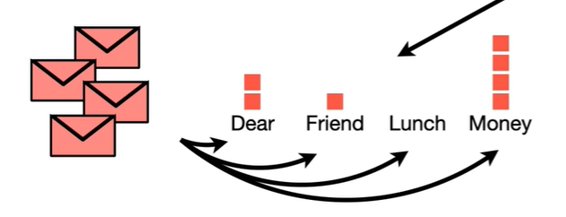
NAÏVE BAYES CLASSIFIER : Spam Messages
Count | Dear | Friend | Lunch | Money | v_{j}
1 | Dear | Friend | Lunch |  | Normal
2 | Dear | Friend | Lunch | Money | Normal
17 | 8 | 5 | 3 | 1 | NORMAL
1 |  | Friend |  | Money | Spam
2 | Dear |  |  | Money | Spam
7 | 2 | 1 | 0 | 4 | SPAM

Slide 13


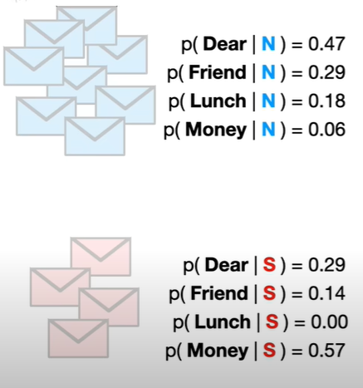


Total NORMAL Messages = 17
Total SPAM Messages = 7
7 % 24 = 0.33
17 % 24 = 0.67

Slide 14





NAÏVE BAYES CLASSIFIER
SPAM
New Message =
NORMAL
0.09 > 0.01
V_{nb} = NORMAL

Slide 15
What’s NAÏVE
Naïve Bayes treats ALL word order the same
That is, the attribute values are conditionally independent
The classification score for the message “Dear Friend” and “Friend Dear” would be the same
Since it ignores the grammar rules, it has High Bias, but it has Low Variance, so it works well in classification

Slide 16
Summary
Naive Bayes learning method involves estimation of various P(vj) and P(ai | vj), based on their frequencies in the data
The set of these estimates corresponds to the learned hypothesis
This hypothesis is then used to classify each new instance by applying the Classifier Equation

Slide 17
THANK YOU

